Slide 1


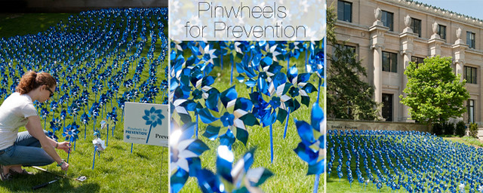
CCISD/CCHS and ZCCWB
3rd Community Drive Thru Event
Observation of April’s Child Abuse Prevention Awareness
“Adopt A Pinwheel/Pinwheel Garden”
Date/Time: Friday, April 30, 2021 p.m. 5:30 p.m. to 7:00 p.m
Where: Crystal City High School Parking Lot
1101 N. 11th Avenue
Crystal City , Texas
Featured Agency
Join us in supporting Child Abuse Prevention Awareness and turning the communities “Blue” .
Community Vendors, Light refreshments, & much more……

